Slide 1

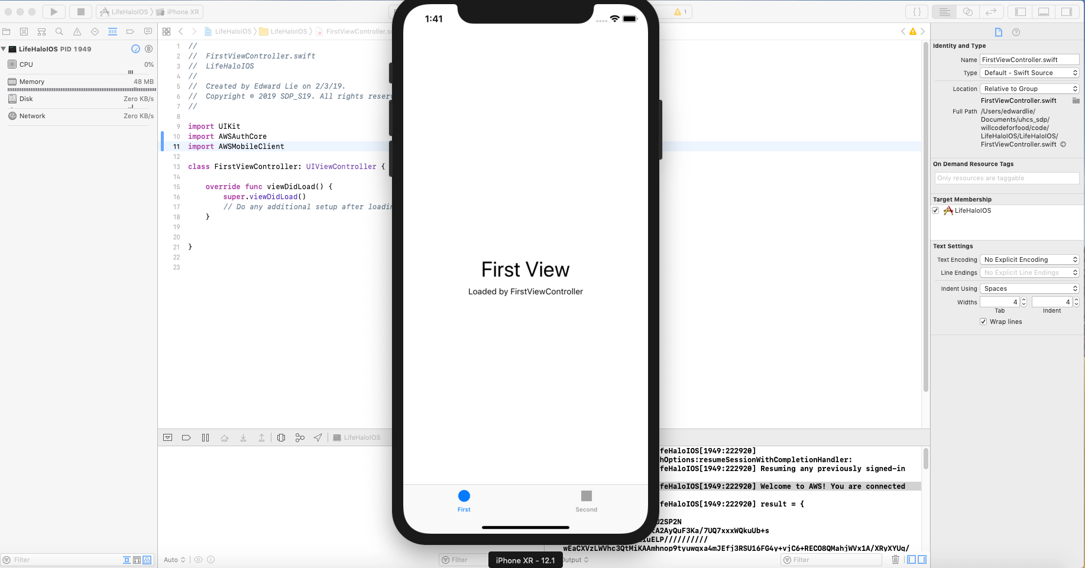
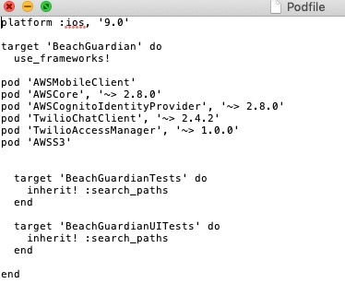
Completed Tasks
This past week consisted mostly of research on AWS, trying to connect the many services together, configuring AWS settings, and writing test code in XCode.
Had issues with committing work to SVN as CocoaPods dependency manager contains file/folder with ‘Target Support Files’ when installed. Resolved by establishing with teammates to individually commit files/folders that do not meet repository naming conventions

Slide 2
Completed Tasks
Designed and revised DB schema
Connected remotely to RDS
Familiarization with RDS console
Created backup of current RDS instance

Slide 3
Completed Tasks
Familiarization with AWS and EC2 consoles
Connected to existing EC2 instance via SSH
Created backup image of the old server, and created a new instance with that image.

Slide 4
In Progress Tasks
Setting up EC2 and RDS
Extending current server codebase and DB schema
Setting up Elastic IP on the new EC2 instance so the API can be reached online
Solve deprecated AWSS3TransferManager exception

Slide 5
Future Tasks
Finalize DB design/modifications
Update PHP to accommodate the changes in the schema
Configure Jenkins to build and deploy the server code

